Slide 1
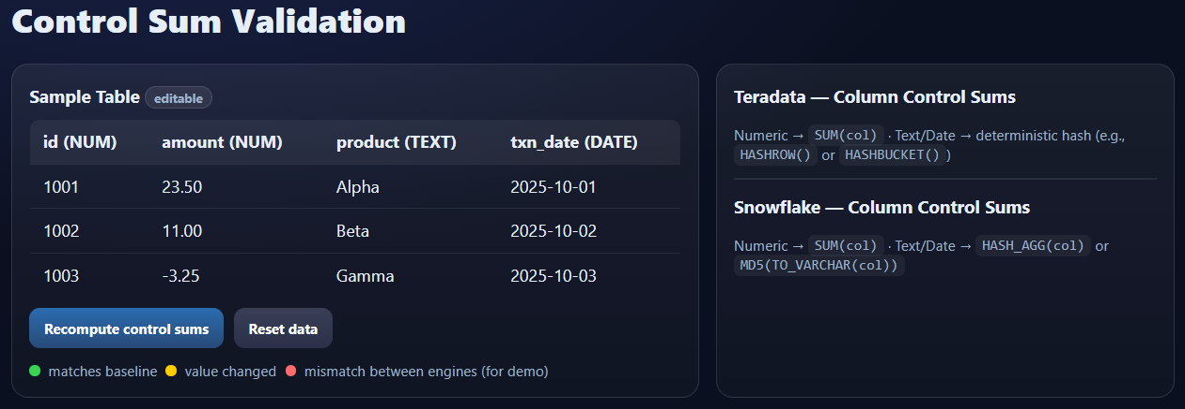

3. Hypercare – Production Parallel Run
OUR approach
To maintain Data Integrity, we will monitor changes in Teradata and sync up final updates to Snowflake before parallel execution.
Snapshot Date
History Data Migration Initiated
Initial History Load Complete
Code Freeze
Catch Up Complete
Parallel Run Complete
DDL
DDL Conversion Complete
DDL Changes Incorporated
Conduct Reconciliation Testing on Data and Reports on Illustrative Acceptance and Variance Thresholds:
Control Sum Validation Variance <1% for noncritical tables
Control Sum Validation Variance 0% for critical tables
ETL
ETL Conversion Complete
ETL Changes Incorporated
Snow-flake
Data
History Data Loaded
Delta Data Catch Up
Processed data sync from Snowflake to Teradata
DDL
Track and Log DDL Changes
ETL
Track and Log ETL Changes
Teradata
History Data Snapshot
Data
Log Data Change Markers
History Data Load
Catch Up Data Load
Parallel Run
Go Live
Changes in the Teradata ecosystem tracked by the Release Management Process

